Slide 1
CP3405 – Design Thinking & Project Management
Run a pilot

Slide 2
Week 1 Summary
Software development is risky business
Empirical rather than predictive methods are best
Scrum as a type of agile method
How agile solves issues with waterfall development

Slide 3
Realize that using the empirical method is actually NOT a new idea
Empirical (not predictive) methods are used in other parts of the business
Example: the sales department needs to react nimbly to changes in the market in these situations:
Competitor actions
New technology
Changing economic situation
Notes:
See page 33-34 for specific sales example

Slide 4
What are the objectives of a pilot study?
A pilot study is a small-scale preliminary evaluation of feasibility, time, costs and/or adverse events (i.e. risks)
It’s used to determine whether empirical methods are the right choice for a company

Slide 5
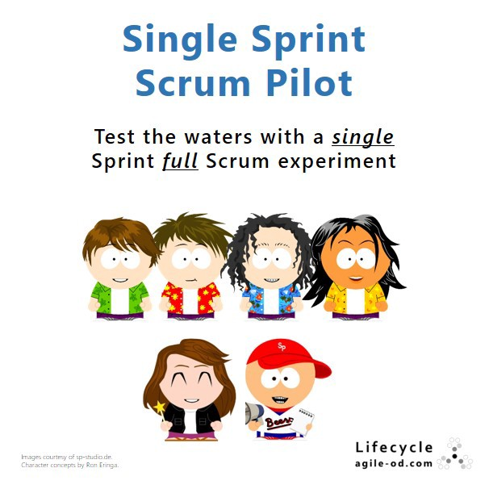
But how long should the pilot study be?
Notes:
https://medium.com/@takeshi.yoshida/scrum-sprint-pilot-6287aac19703
Answer: The overall pilot study could be 2-3 iterations (sprints), a sprint is typically between 1 week to 4 weeks long

Slide 6
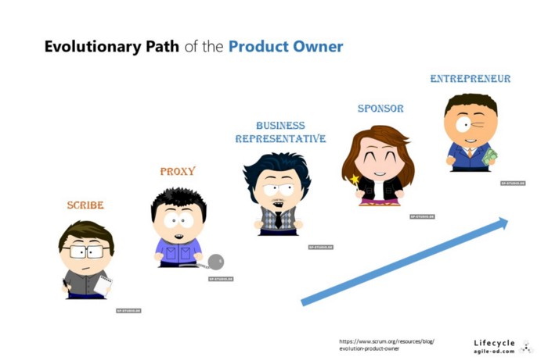
Notes:
https://medium.com/@takeshi.yoshida/scrum-sprint-pilot-6287aac19703

Slide 7
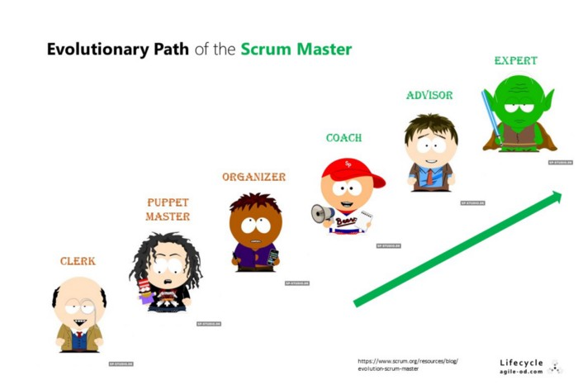
Notes:
https://medium.com/@takeshi.yoshida/scrum-sprint-pilot-6287aac19703

Slide 8
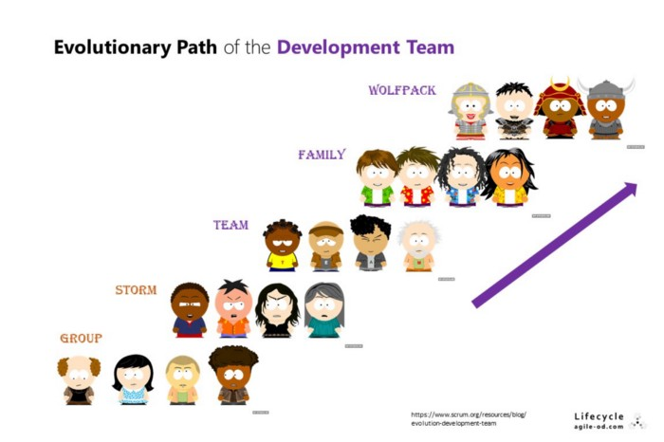
Notes:
https://medium.com/@takeshi.yoshida/scrum-sprint-pilot-6287aac19703

Slide 9
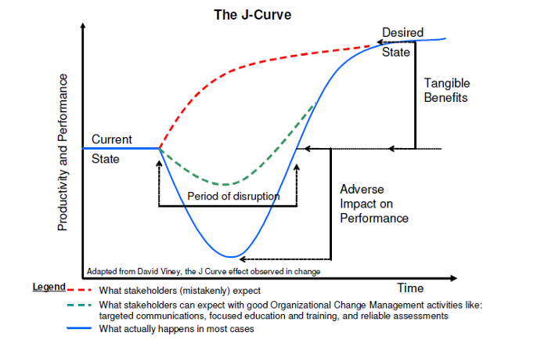
Scrum is known to have a J-curve effect - a temporary drop in productivity before improvements
Notes:
https://medium.com/@takeshi.yoshida/scrum-sprint-pilot-6287aac19703

Slide 10
The move from predictive to empirical must be considered carefully…
What should happen if the pilot fails?
How much time and money is the company willing to sink into the process?
What should happen if the pilot succeeds?
Will the company move directly to empirical based methods, or does it need to ease into it gradually?

Slide 11
So what exactly should we pilot?
Select a non-trivial problem that’s tricky, difficult or not well understood

Slide 12
The Pilot study process:
Form the team
Figure out what you want to pilot
Do a small piece of it, completely
Evaluate what you want to do next
Assess what can be improved and do it
Continue iterating steps 3-5 until satisfied
Notes:
Form the team. Bring the sales force together, discuss how the company is doing, review the competitive landscape, and inform salespeople of any new products.
Figure out what you want to do. Project the sales pipeline, targets, and revenues for the year with decreasing precision. Assign territories and quotas.
Do a small piece of it, completely. Sell for a month and see what happens. Also see what happens to the pipeline for the future.
Evaluate what you want to do next. Update the pipeline and refocus the efforts for the upcoming month.
Continue doing and evaluating. Repeat these steps each month.

Slide 13
Case study: developing a funds management phone app
Financial organization uses several external mutual funds that customers access via online interfaces
VP suggested that a phone app would be more useful for their customers, keep them engaging with the company rather than external companies and draw new customers
IT department said they would need 5-6 months to develop requirements using 5 analysts and a project manager (cost $500,000)

Slide 14
Case study: developing a funds management phone app
After the requirements analysis the software would still need to be built at an unknown cost (at present because requirements are still unknown)
VP suggested piloting this idea using $125,000 for 3 software developers and 3 iterations (3 months) and building the basic functionality

Slide 15
Before the pilot
First the VP had to convince the boss, managers for the division and IT steering committee that running the pilot made good business sense
VP presented evidence for the pilot:
Pilot to determine whether the software development was a good choice for their business
Showed how software would align with business strategies
Described empirical process
Outcomes would be working app that could be developed further and trial of empirical-based IT dev methods

Slide 16
Make modifications to planned pilot based on input
The proposal was accepted with two modifications:
Add an IT project manager with previous experience in empirical based software development (already on staff)
Meet with stakeholders monthly to evaluate team progress

Slide 17
Step 1: Form the team – Case study
Chose full-time staff already working for the company
Developers already skilled technologies that would be used
No need for access to outside skills for parts of project
Awareness of iterative development process
Enthusiast volunteers, not draftees
Set up good workspace for team (open plan, whiteboards, co-located with VP)
Schedule would be normal work-days only not death march

Slide 18
Potential problems in forming the team
Make sure that if you do bring in outsiders for project that your internal stakeholders are supportive of the pilot or at least silent on the matter
Text gives example of company that failed to hire any developers because in-house staff were hostile to the idea of changing from predictive to empirical methods
Try to get buy-in from stakeholders, especially if the directives for the pilot come from the top

Slide 19
Step 2: Figure out what you want to do – Case study
Goal for the project is to determine if empirical, iterative methods could be used to build some software in 3 months
Team needed to get to know each other
Determine interface look and feel, basic functionality, security, performance and stability
Determine which pieces could be done in each of the three iterations
Things needed to discover in first iteration:
Can the team build the app using this technology
Can the app access needed systems without using existing web interface?
What does the app look like roughly?

Slide 20
Step 2: Figure out what you want to do
Team needed to learn how to work together
Since there were no requirements given, the team needed to come up with these items themselves
They argued best approaches and team members frequently disagreed completely
The team manager (who had worked on iterative projects before) helped them establish ground rules that would lead to the trust needed to resolve differences of opinion
Not putting other ideas down
Not disparaging others
Not calling each other negative names
These rules are needed when working in a small team in open spaces

Slide 21
Step 3: Do a small piece of it, completely
Team needed to plan what the software would look like and how to turn the design into completed software
Team decided to meet every day, take stock of what had been completed the day before, discuss any problems and decide what should be worked on the next day
As they created the software they devised tests to ensure that all pieces of functionality were created
Other people in the company would often come up and insist that certain things be added to software
Team manager would tell them to go away, and for team members to stick with their current plan

Slide 22
Step 4: Evaluate what you want to do next – Case study
At the end of the first month, the team met with the stakeholders
The completed software worked well and contained all of the functionality decided upon by the team.
Some stakeholders were unhappy that further progress had not been made and moved to abandon the pilot
VP said in the first iteration they were learning the process, building the team and other important items not reflected in functionality produced
Decided to continue with the pilot

Slide 23
Step 5: Assess what can be improved and do it – Case study
The team held a retrospective meeting, to discuss the iteration and what could be improved
Common outcomes of a first iteration can be:
Very little functionality was developed. Why?
Functionality delivered may not be close to what was desired. Why?
The iteration felt very awkward. Why?
The team members didn't work together well. Why?
At this point the team recommended changes to improve their process for the next iteration

Slide 24
Step 6: Continue doing and evaluating until finished – Case study
A pilot typically produces two outcomes:
Usable software
Information about how iterative development works in the company
The assessment is not just whether the empirical process works.

Slide 25
Step 6: Continue doing and evaluating until finished – Case study
Iterative develop allows you to see friction points in the software development
Where are the roadblocks or bottlenecks?
Are team members able to work full-time on the project or are they constantly called away to other work
Iterative development often changes how a company interacts with it's software development team

Slide 26
Outcomes of empirical methods
Self-organization of teams
Iterations need to be 30 days or less so team doesn't lose focus
Self-organization empowers workers to solve their own problems and make decisions
Cross-functionality
Team members volunteer to work on specific areas, in collaboration with entire team
Knowledge is shared and collaboration ensures more creative solutions

Slide 27
Week 2 Summary: Running a pilot study
Steps in running a pilot study
Form the team
Figure out what you want to pilot
Do a small piece of it, completely
Evaluate what you want to do next
Assess what can be improved and do it
Continue iterating steps 3-5 until satisfied

